Slide 1
Using For Loops
Notes:
Hi, in this video we’re going to learn about how for loops can help us repeat code. Let’s get started!

Slide 2
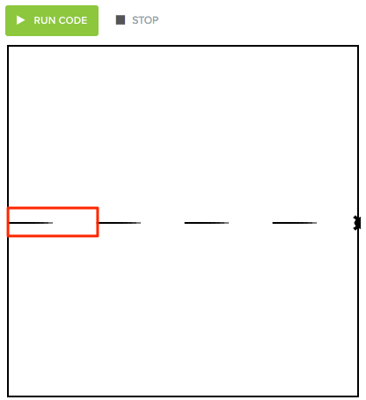
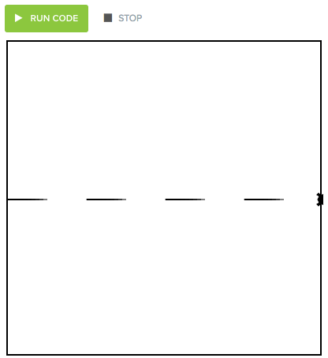
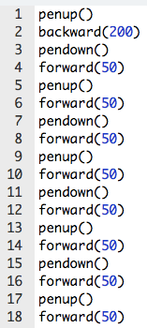
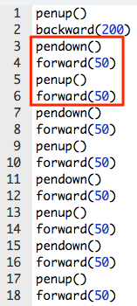
Repeating Code
Repeat 4x
Notes:
When you completed our dashed line program, you wrote 18 lines of code in order to get the result we were looking for.
You wrote these (click for red box image) four lines of code to make one line with blank space after (click for red box image). You then had to copy and paste this 3 more times to make the rest of the lines.
What if we wanted to make a dotted line? We would need to repeat this code many, many times.
What if we had a way to just tell Tracy (click for textbox) to repeat this section of code? Well, we do!

Slide 3
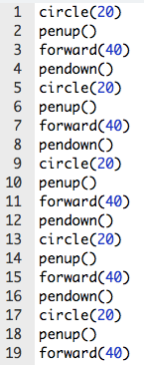
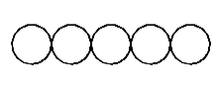
Introducing Loops!
For loops are used to repeat code a fixed number of times.
Notes:
For loops are used to repeat code a fixed number of times. So instead of copying and pasting code to create your caterpillar with 5 circles...

Slide 4
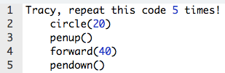
Introducing Loops!
For loops are used to repeat code a fixed number of times.
Notes:
...you can just tell Tracy ‘repeat the code to make a circle 5 times’. This helps us a lot when we need to repeat something many times because all we need to do is write how many times we want the code to repeat. Making a caterpillar with 50 circles is now as easy as making one with 5!

Slide 5
Introducing For Loops!
For loops help us by:
shortening our code
making it easy to alter our code
19 lines to 5 lines!
Notes:
Loops help us by shortening our code (click for arrow and highlight), which is something all programmers strive to do because this makes our code easier to read. Using this loop instead of writing all of our commands out took our 19 lines of code and reduced them to 5 lines!

Slide 6
Introducing Loops!
Loops help us by:
shortening our code
making it easy to alter our code
Change radius to 50 pixels
Notes:
Using loops also (click for highlight) makes it a lot easier to alter our code when needed. What if we wanted to make a fatter caterpillar where each circle (click for arrow) had a radius of 50? In order to do this with our initial code, we would need to retype the radius (click for circles) in 5 different places. In our looped code, (click for circle) we just need to change one value and the radius for all circles is changed.

Slide 7

Writing For Loops
for i in range (amount of times to repeat):
Commands to repeat go here (indented!)
Write loop
Notes:
Before we can start using loops, we need to know exactly how to write them so that Tracy will understand.
To tell Tracy to repeat something, we need to begin by writing this phrase ‘for i in range’ and put a number in parentheses. We need to end the phrase with a colon. This complete phrase communicates to Tracy that whatever we write indented below it is code that we want her to repeat based on the number we wrote in parentheses.
Let’s look at our caterpillar example. We want Tracy to put her pen down, draw a circle, lift her pen up, and move forward and we want her to do this sequence 5 times.
We write this code by using for i in range (5) with a colon and then writing all the commands we want her to repeat indented below it.
Let’s look at some examples of using loops in our code editor.

Slide 8
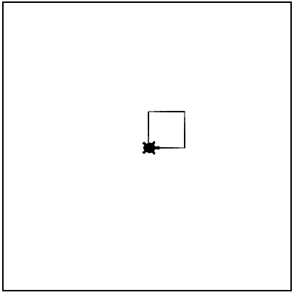
Example #1: Square Using Loops
Write a program that has Tracy draw a square with sides of 50 pixels using a for loop.
Notes:
In our first example, we want Tracy to use a for loop to draw a square.

Slide 9
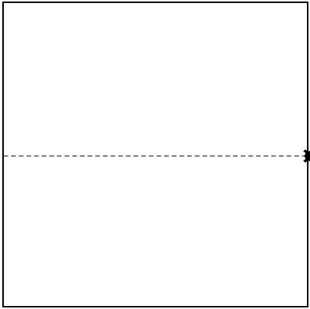
Example #2: Dotted Line
Write a program that has Tracy draw a dotted line along the x-axis of the canvas.
Notes:
In this example, we want to draw a dotted line across the width of our canvas where each dash and space is only 5 pixels wide.

Slide 10
Commands Learned this Lesson
Command | What does it do?
for i in range(number) | Initialize a loop
Notes:
In this lesson, we learned how using for loops can shorten our code and make it easier to make adjustments. Use for loops to solve the next set of Tracy exercises!

